Slide 1
IPAK Report: Post-vaccination Death Causality Likely Given Temporal Distribution of Deaths Following COVID19 Vaccinations
Data Source: VAERS
Deaths til 3/11/2021
Author: James Lyons-Weiler, PhD
CEO/Director The Institute for Pure and Applied Knowledge

Slide 2
Design
If deaths following COVID19 vaccinations are not causally linked, the reported number and percentage of deaths should be equally distributed across days following vaccination.
There should not be an excess of reports on Day 0, 1, 2
If risk wanes with time, the risk should diminish each day.
Data: VAERS data, all fatalities, full VAERS database accessed 3/11/2021
Analysis: Chi-Square ${\text{c}}^{2}$ test, α=0.05

Slide 3
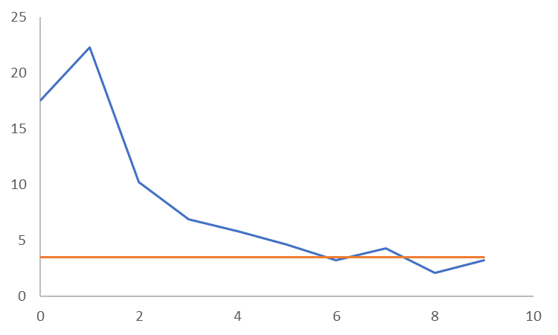
Deaths Following COVID19 Vaccine to 3/10/2021
% of
Reported
Deaths
Observed
Expected (8% per day) (p<< 0.000001)
8.9%
(14%)
10.96%
(54%)
15-30
10-14
Days Following COVID19 Vaccination

Slide 4
Conclusion
The hypothesis of equal distribution among days following the vaccine has been tested and is falsified.

Slide 5
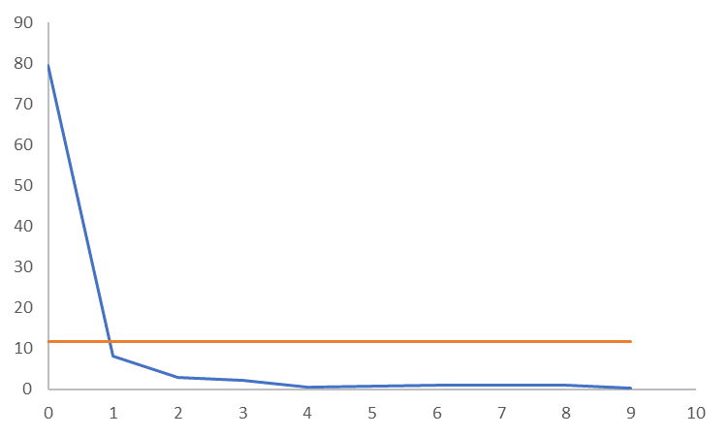
Anaphylaxis Following COVID19 Vaccine to 3/10/2021
% of
Reported
Cases
Observed
Expected (8% per day) (p<< 0.000001)
1.42%
(5.6%)
0.568%
(2.8%)
Days Following COVID19 Vaccination
10-14
15-30

Slide 6
For more information: info@ipaknowledge.org
Please cite as:
IPAK Report 2021-1. 2021. Post-vaccination Death Causality Likely Given Temporal Distribution of Deaths Following COVID19 Vaccinations. Interim results. http://ipaknowledge.org/Publications.php

