Slide 1
Cancer Biomarkers Research HPV and Cancer HPV Vaccine
James Lyons-Weiler
Institute for Pure and Applied Knowledge
October, 2018

Slide 3
Types of Biomarkers
Genetic
Genomic
Proteomic
Metabolomic
Epigenetic

Slide 4
Biological Specimen
Serum
Urine
Breath
Saliva
Blood
Fecal
Circulating cells

Slide 5
Uses of Cancer Biomarkers
Diagnosis/Molecular Staging
Therapy outcome prediction
Personalized Medicine

Slide 6
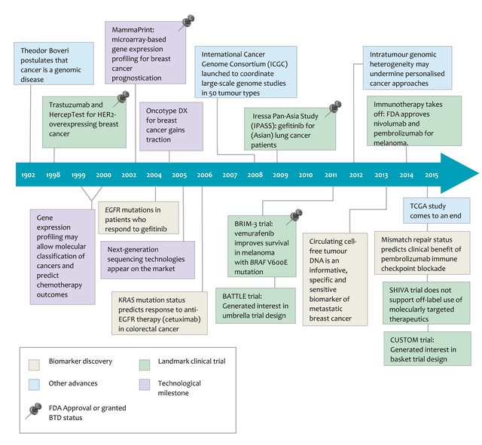
Syn NL Expert Opin Drug Metab Toxicol. 2016 Aug;12(8):911-22

Slide 7
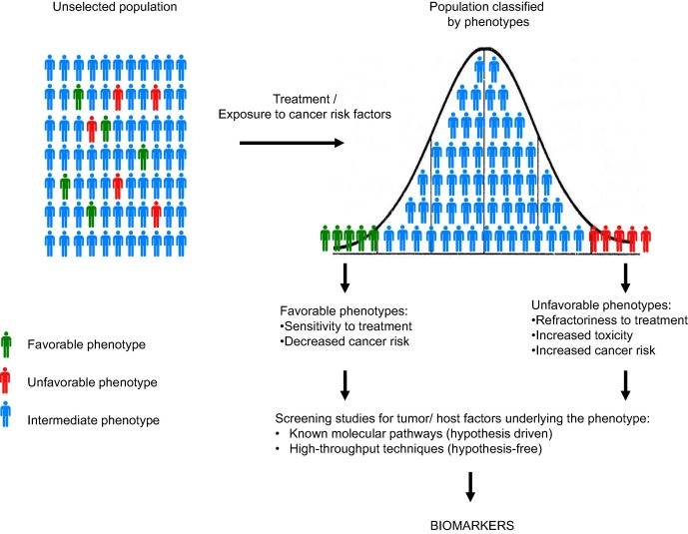
Perez-Garcia et al. 2017. Cancer Treatment Reviews 53:79-97.

Slide 8
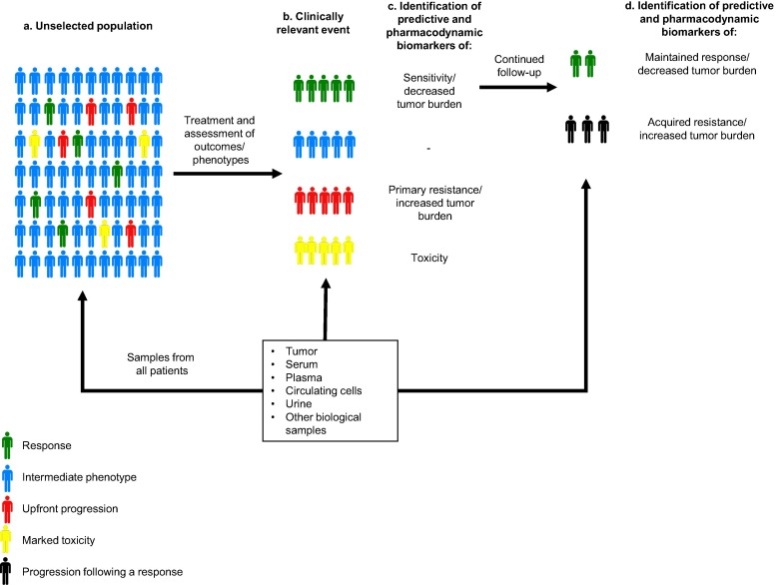
Perez-Garcia et al. 2017. Cancer Treatment Reviews 53:79-97.

Slide 9
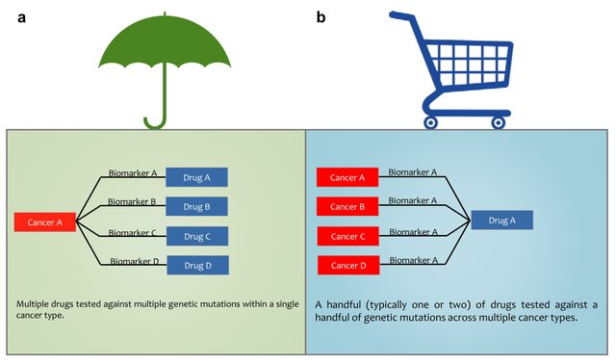
Basket vs Umbrella Biomarkers
BATTLE
I-SPY 2
Lung-MAP
FOCUS2
NCI Match
NCI MPACT
Syn NL Expert Opin Drug Metab Toxicol. 2016 Aug;12(8):911-22

Slide 10
https://slideplayer.com/slide/9568857/

Slide 11
https://slideplayer.com/slide/9568857/

Slide 13
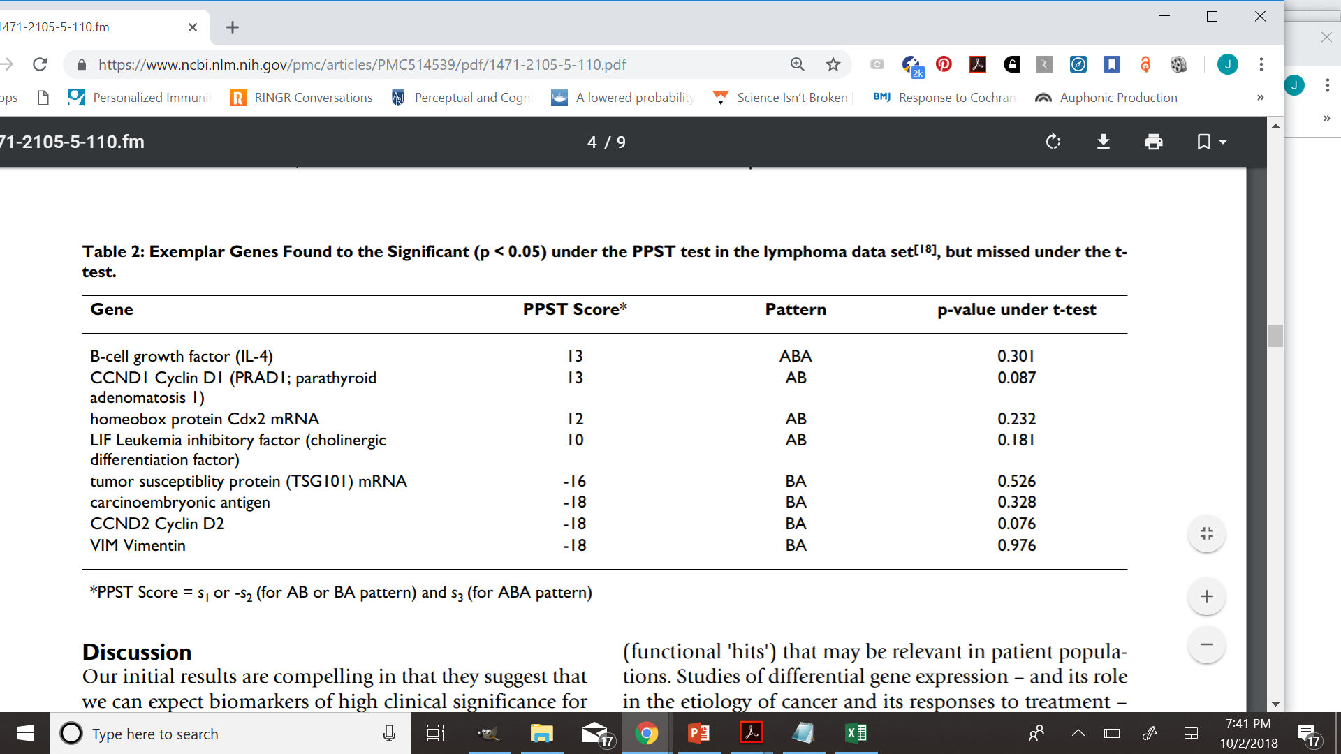

Slide 14
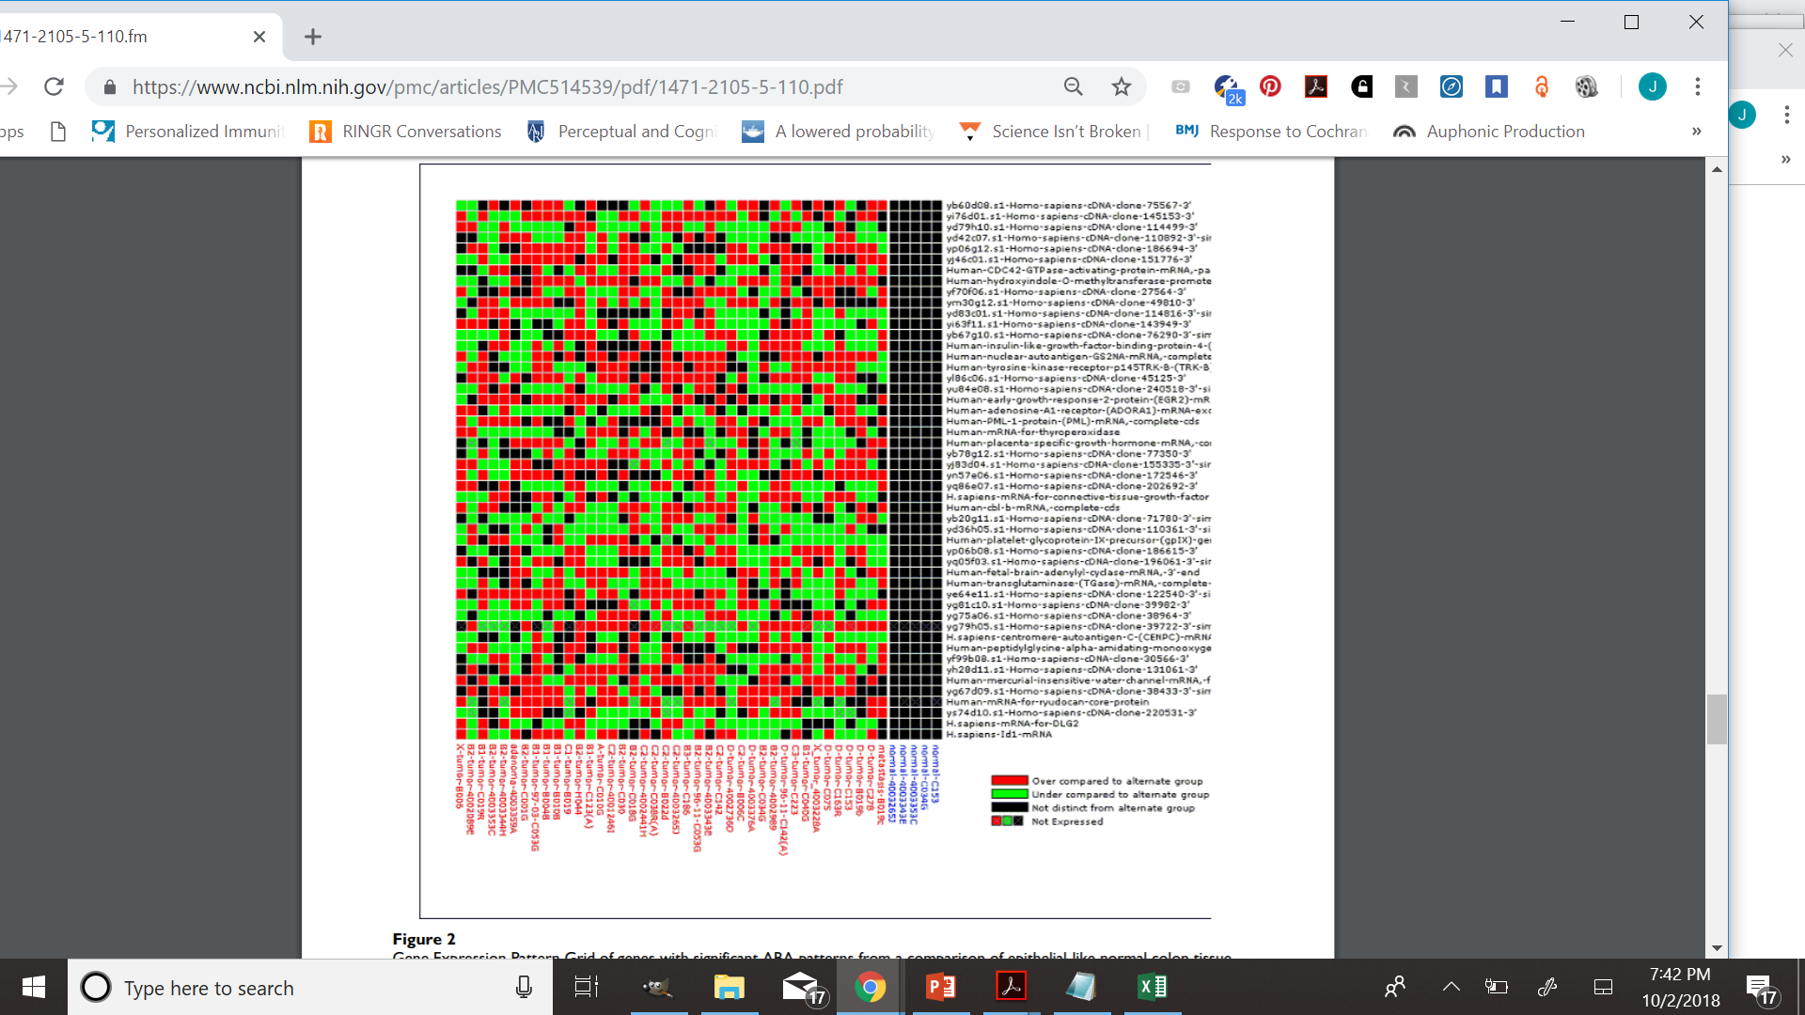

Slide 15
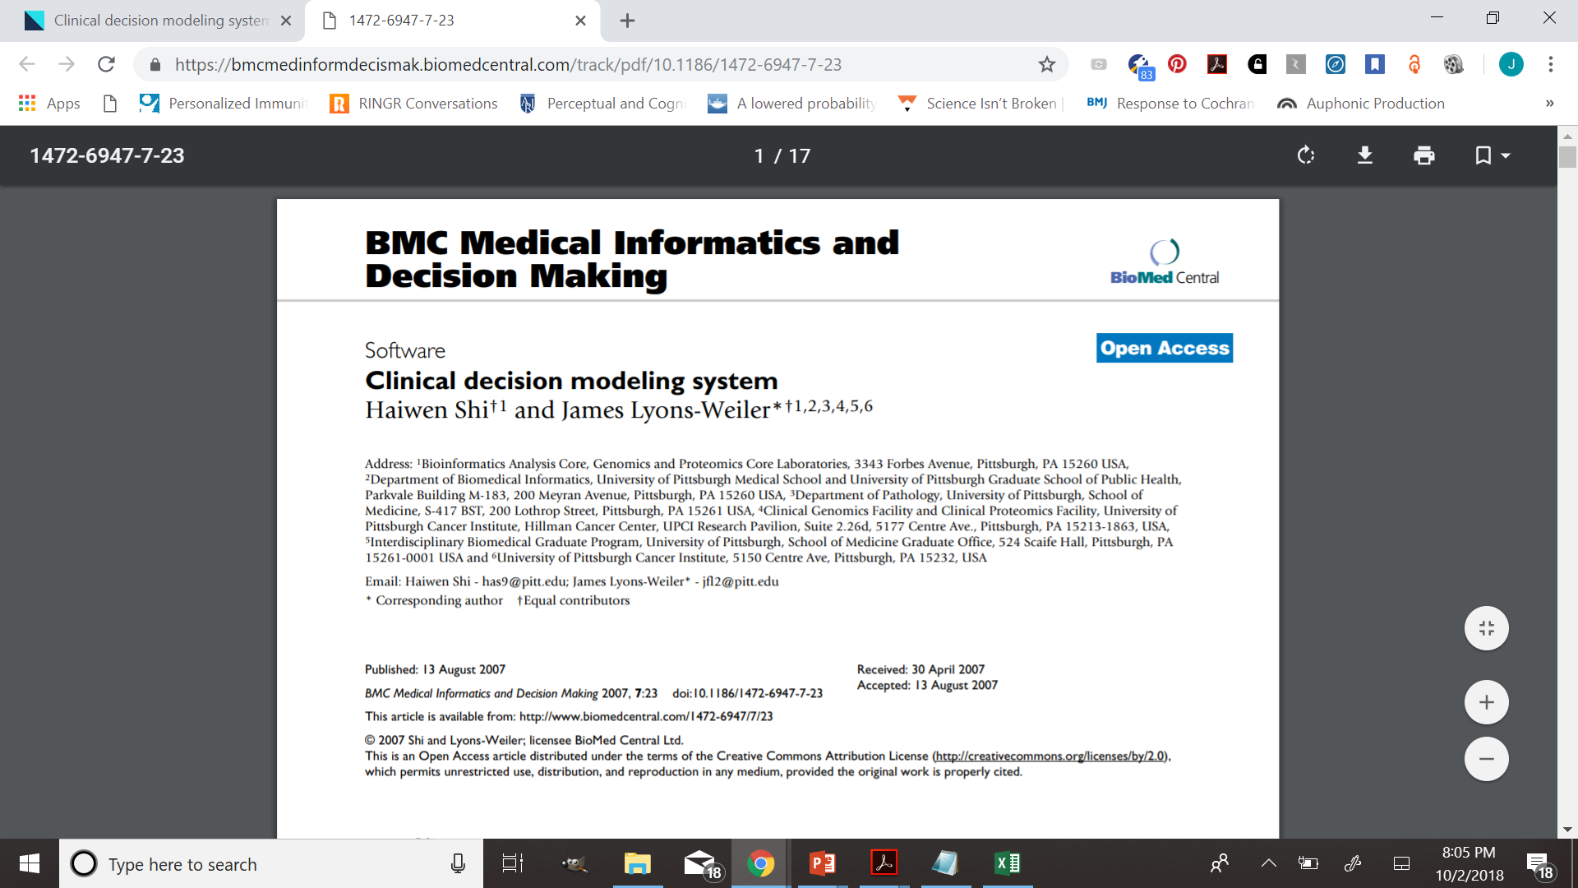

Slide 17
Bravo et al. 2010 Trends in Microbiology 18:432-438

Slide 18
HPV and Cancer
High Risk HPVs (e.g., 16, 18, 26, 31, 33, 35, 39, 45, 51, 52, 53, 56, 58, 59, 66, 68, 69, 73, and 82)
Low-risk HPVs (6, 11, 40, 42, 43, 44, 54, 61, and 70)
Type Association with Pathologies
Cervical cancer – 100%
Anal cancer
Throat cancer
Penile cancer
Genital warts – HPV 2-like
Plantar warts – HPV 2-like

Slide 19
170 types
de Villiers, 2004. Classification of papillomaviruses. Virology 324:17-27

Slide 20
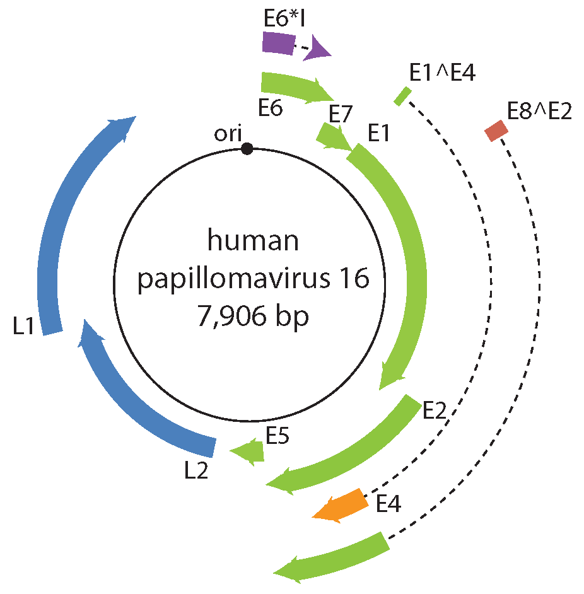
https://talk.ictvonline.org/ictv-reports/ictv_online_report/dsdna-viruses/w/papillomaviridae

Slide 21
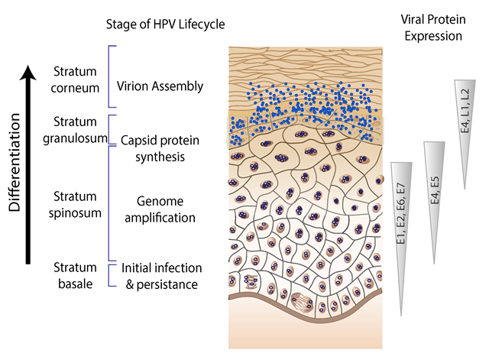
https://talk.ictvonline.org/ictv-reports/ictv_online_report/dsdna-viruses/w/papillomaviridae

Slide 22
Molecular Virology of HPV
HPVs are double-stranded DNA viruses that replicate within stratified squamous epithelia that need micro-abrasions or areas of transitional epithelium, such as in the cervix, anus, and tonsils, to be able to infect epithelial cells [20]. After infection, the virus makes use of the cells’ normal DNA replication machinery to produce further viral genetic fragments at the supra-basal layer of the epithelium [20,21]. Like all papillomaviruses, HPVs establish productive infections only in keratinocytes of the skin or mucous membranes.
-Crosignani et al. 2013. Towards the eradication of HPV infection through universal specific vaccination

Slide 23
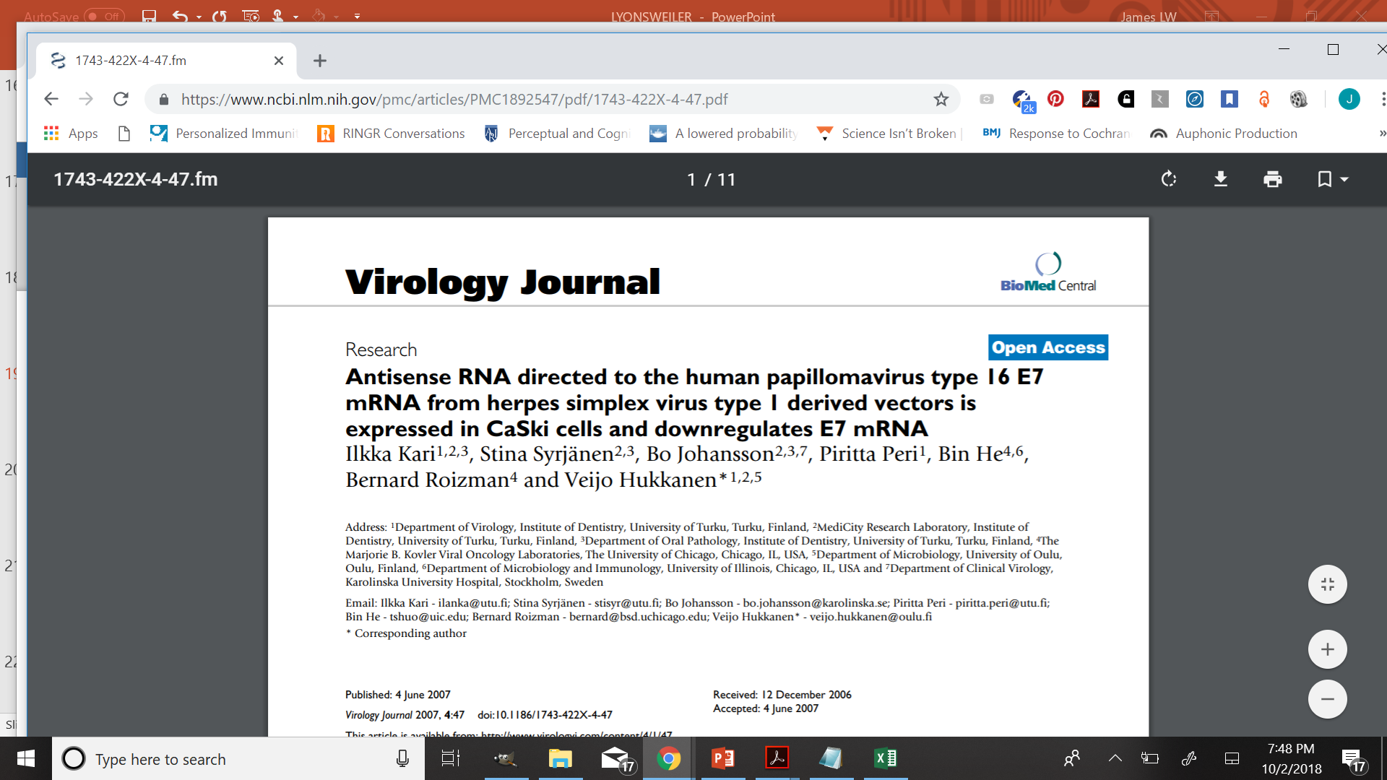

Slide 24
Partial Knowledge

Slide 25
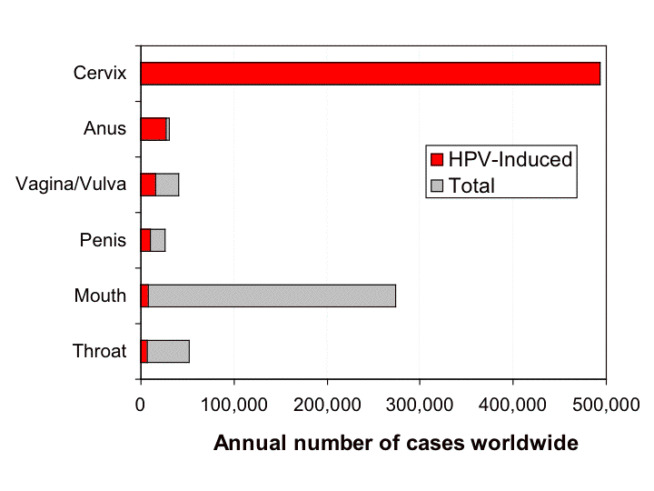
Parkin DM 2006. The global health burden of infection-associated cancers in the year 2002. Int. J. Cancer. 118 (12): 3030–44.

Slide 26
Multiple and Persistent Infections
Persistent hr HPV infection is widely associated with the development of cervical cancer (implies immune system weakness)
Vaccination of individuals with multiple infections appear to lead to increased risk of CIN1 and CIN2 lesions post-vaccination

Slide 27
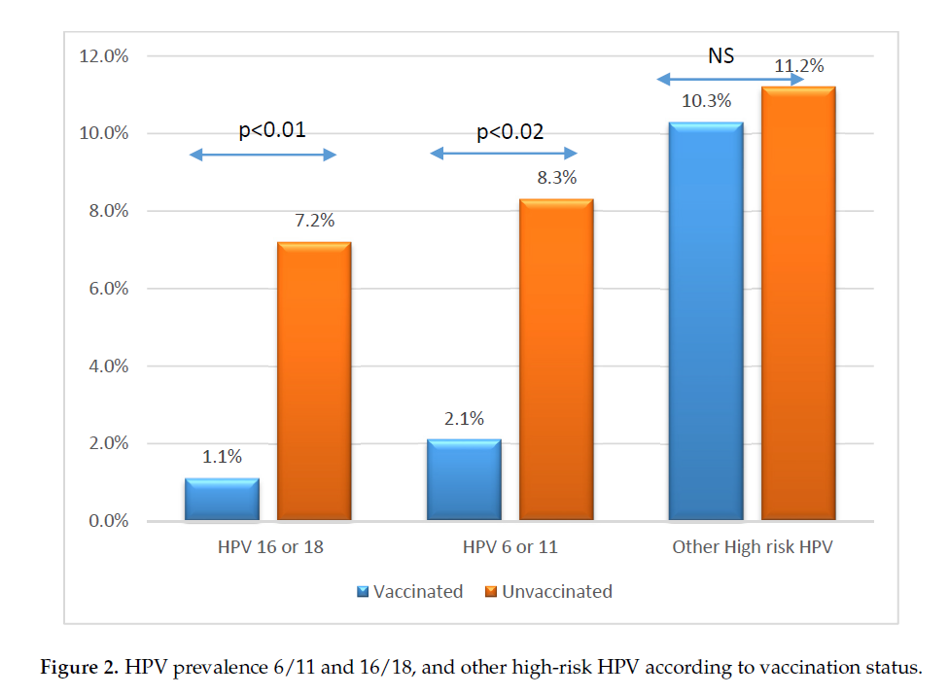
HPV Vaccine Reduces Vaccine Targeted Types
Jeannot et al.. 2018: (Prevalence of Vaccine Type Infections in Vaccinated and Non-Vaccinated Young Women: HPV-IMPACT, a Self-Sampling Study)

Slide 28
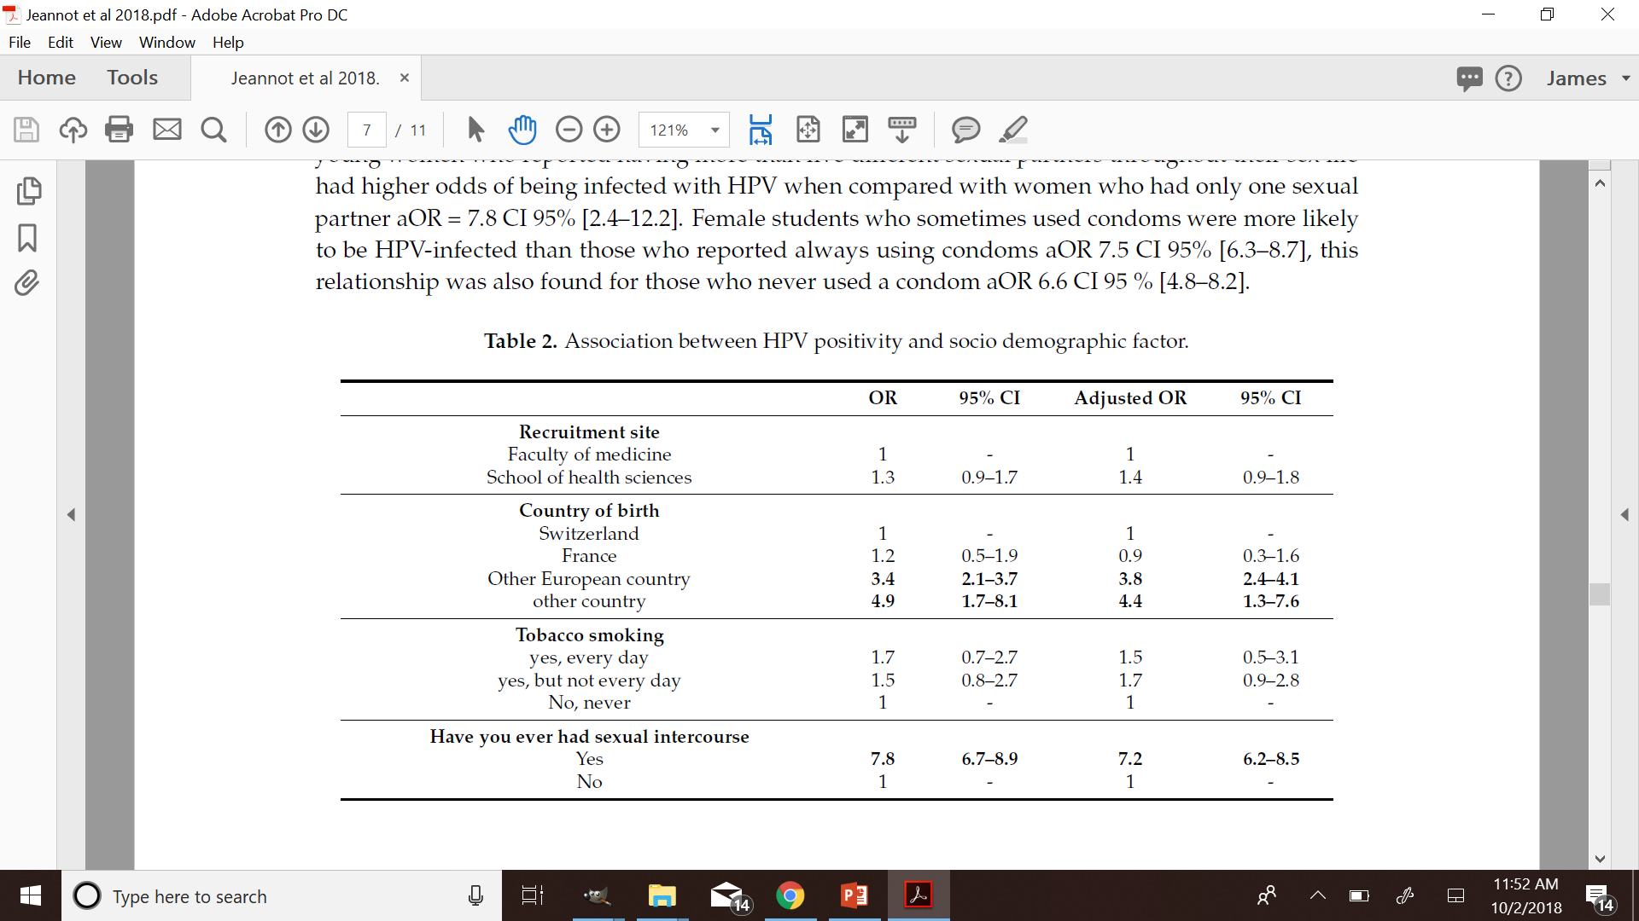

Slide 29
HPV Vaccine Development History
HPV-4
HPV-9
Cervarix
Merck’s submissions are all reviewed in Holland et al. (2018)

Slide 30
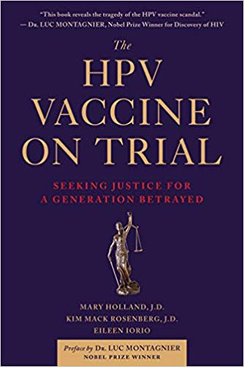

Slide 31
ANTIGEN
+
ADJUVANT
INERT
ADJUVANT
HPV
VACCINE
SALINE
AAHS
VALID
PLACEBO
INVALID
PLACEBO
EXPOSURE
(TREATMENT)

Slide 32
Key Findings
The one RCT on market demographics (12-18 year olds) used a different formulation than the vaccine brought to market (1/2 AAHS)
HPV studies used AAHS vs. Vaccine. AAHS is an invalid placebo (saline alone should have been used). Equal levels of morbidity and mortality were found.
HPV-9 was compared to HPV-4. Equal levels of morbidity and mortality were found.
Girls in the control arm were vaccinated at the end of the trials, thus doubling their exposure to AAHS

Slide 33
ANTIGEN
+
ADJUVANT
ANTIGEN
+
ADJUVANT
ADJUVANT
AAHS
HPV4
HPV9
INVALID
PLACEBO
INVALID
PLACEBO
EXPOSURE
(TREATMENT)

Slide 34
Adapted from Holland et al.(2018)
HPV vaccines have never been shown to prevent cancer of any kind.
Japan no longer recommends HPV vaccines following injuries
The clinical trials never investigated the vaccine’s possible effects on human fertility or potential to cause cancer.
The clinical trials show that the vaccines contribute to HPV lesions, and potentially cancer, in some women. Despite this, neither the manufacturers nor government agencies recommend prescreening to eliminate those with clear risk factors.
Although the vaccine is targeted for 11-12-year-old children, and legal for children as young as 9, only a small fraction of clinical trial subjects was in this age range.
Lawsuits against HPV vaccine manufacturers and government health agencies are progressing around the world, including the US, India, Japan, Colombia, Spain, and France.
Although the US government proclaims HPV vaccines safe and effective, it has paid out millions of dollars to compensate families for death, brain injury, multiple sclerosis, ulcerative colitis, and other severe, debilitating conditions.

Slide 36
Flaws in the clinical trials for Gardasil made it harder to properly assess safety

Slide 37
Type Replacement
Aside from potential issues related to duration of protection, type replacement is the main biological phenomenon that may limit the success of vaccine efforts aimed at reducing morbidity and mortality associated with cervical HPV infection – Tota et al. 2016

Slide 38
Models and Simulations
The numerical simulations of our model indicate that the application of the vaccine declines infection by target genotypes as expected. However, our results on dynamics of nonvaccine HPV types infection show the possible presence of a biological mechanism: vaccine-induced pathogenic strain replacement, for example, an increase in the prevalence of HPV genotypes not targeted by the vaccines due to an ecological niche created by a reduction in the prevalence of HPV genotypes targeted by the vaccines - Peralta, 2014
“In this context, our mathematical model correctly predicts the emergence of viral genotypes nontarget of the vaccine similar to the aforementioned phenomenon.”

Slide 39
Models and Simulations
“We … find that the removal of HPV type 16, type 18, and types 6 and 11 would increase the prevalence of nontargeted types by 50%, 29%, and 183%, respectively.” Durham et al. 2012. Reevaluation of epidemiological data demonstrates that it is consistent with cross-immunity among human papillomavirus types.

Slide 40
Type Replacement Found
Fischer, S. 2016. Shift in prevalence of HPV types in cervical cytology specimens in the era of HPV vaccination. Oncol Lett 12:601-610.
Guo et al., 2015. Comparison of HPV prevalence between HPV-vaccinated and non-vaccinated young adult women (20-26 years)American Association for Cancer Research Meeting, Apr 18-22; Philadelphia, PA. Philadelphia (PA): AACR; 2015. Abstract nr 844
Mollers M et al., 2014. Population- and type-specific clustering of multiple HPV types across diverse risk populations in the Netherlands. Am J Epidemiol. 179(10):1236-46. doi: 10.1093/aje/kwu038.
Giambi C et al., 2013. A cross-sectional study to estimate high-risk human papillomavirus prevalence and type distribution in Italian women aged 18-26 years. BMC Infect Dis. 13:74. doi: 10.1186/1471-2334-13-74.

Slide 41
Type Replacement Detected, but Dismissed
“Our main analysis showed increases in other nonvaccine HPV types (HPV39, HPV52, HPV53, HPV58, and HPV73), but these increases were inconsistent for the 2 age groups examined and the vaccines used.”
Mesher et al., 2016. Assessment of the population-level impact of a high coverage HPV immunisation programme in young females

Slide 42
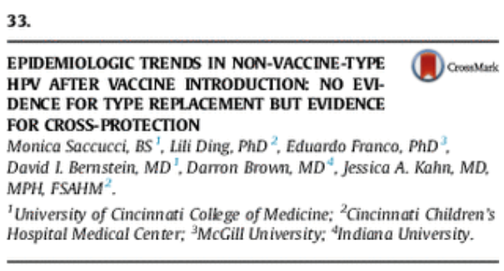
Type Replacement Detected, But Not Significant

Slide 43
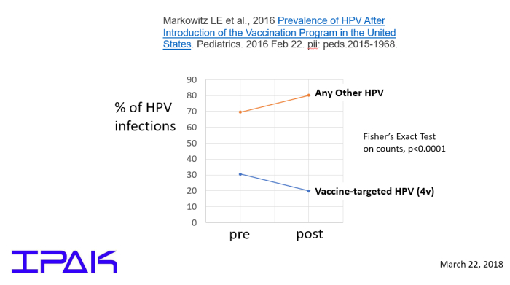
Type Replacement Detected, but Denied
Markowitz LE et al., 2016 Prevalence of HPV After Introduction of the Vaccination Program in the United States. Pediatrics. 2016 Feb 22. pii: peds.2015-1968.

Slide 44
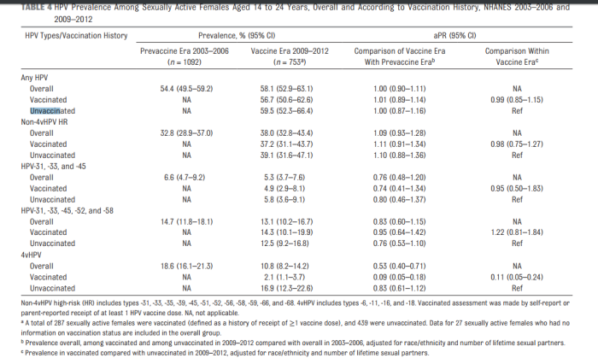
No Net Change in HPV Infection Rates Pre- and Post Vaccination

Slide 45
Type Replacement Detected, but Denied
Markowitz LE et al., 2016 Prevalence of HPV After Introduction of the Vaccination Program in the United States. Pediatrics. 2016 Feb 22. pii: peds.2015-1968.

Slide 46
Studies that Do Not Find Type Replacement

Slide 47
Are Two Populations Being Vaccinated? Three? Or One? Correlation <> Causation
For women recruited from a health department clinic, older age (OR = 1.4, 95% CI: 1.2-1.6) and consistent condom use with main partner in the past 3 months (OR = 11.6, 95% CI: 3.4-40) were associated with being unvaccinated. For women recruited from a teen health center African American race (OR = 0.2, 95% CI: 0.07-0.7) and having Medicaid health insurance (OR = 0.3, 95% CI: 0.1-0.7) were inversely associated with being unvaccinated. The observed increase in non-vaccine-type HPV prevalence in unvaccinated women may be explained by differences between unvaccinated and vaccinated women.
Ding et al. Differences between vaccinated and unvaccinated women explain increase in non-vaccine-type human papillomavirus in unvaccinated women after vaccine introduction Vaccine 35:7217-7221.

Slide 48
“Correcting For” and “Adjusting For” Risk Factors, Exposures and Outcomes
A study focused on all-cause mortality and smoking tallies all deaths in smokers and non-smokers.
The authors find an association.
The authors decide to “correct for” a common medical condition and the association is no longer significant.
They conclude that it is unlikely that smoking contributes to mortality in humans.
The common medical condition? Cancer.

Slide 49
Problematic Across-Group Adjustments
# of office visits
smoking
# of sexual partners
income
age of sexual debut
use of hormonal birth control
presence of other STD (e.g., Chlamydia trachomatis)
If these are different at baseline, those differences may be representative

Slide 50
Simulated Example (for this course)
$P_{i}$, $P_{j}$, $P_{k}$… $P_{n}$
Time 1
(After
Vaccination)
$P_{i}$, $P_{j}$, $P_{k}$… $P_{n}$
Time 0
(Pre-Vaccination)

Slide 51
Time 1
(After
Vaccination)
Sexual Activity

Slide 52
T1/SA
$P_{i}$, $P_{j}$, $P_{k}$… $P_{n}$
Time 0
(Pre-Vaccination)

Slide 53
Examples from HPV Vaccine Studies
Example #1. Carozzi et al., 2018: No Type Replacement Found after “Association adjusted for the following variables: marital status, smoking status, number of sexual partners in the past 6 months, number of lifetime sexual partners, and sexually transmitted diseases”
Example #2. Gray et al., 2018. “The PR and OR estimates were adjusted for participant mobility, for community-level prevalence of regular smoking and for individual level C. trachomatis status, reflecting the risk-taking behavior”
Example #3. Mesher et al. 2016. Continuing reductions in HPV 16/18 in a population with high coverage of bivalent HPV vaccination in England: an ongoing cross-sectional study Adjusted ORs were calculated adjusting for age, testing venue type and chlamydia positivity (as a marker for sexual behaviour).

Slide 54
Performing Multiple Comparisons When One Will Do
A ztest of 2 proportions was used to assess differences in HPV type–specific prevalence among women who received all 3 doses of the vaccine and those who received none. The Bonferroni correction (significance level α = 0.05/22) was used because of the multiple statistical testing conducted for the 22 nonvaccine HPV types detected by the assay. Significance was assessed at α = 0.05 for HPV types 16 and 18. Association between the number of doses of vaccine received and HPV outcome was measured by using logistic regression adjusted for deprivation score, birth cohort year, and age at vaccination.
Cameron et al. Human Papillomavirus Prevalence and Herd Immunity after Introduction of Vaccination Program, Scotland, 2009–2013

Slide 55
So… Vaccinated and Unvaccinated People Don’t Have Sex?
“Our findings, revealing similar or higher incidence of nonprotected
HPV types in the control arm compared with the HPV arm across all our analyses, provide strong evidence that type replacement is unlikely to occur among vaccinated individuals”
-Tota et al. 2016 Evaluation of Type Replacement Following HPV16/18
Vaccination: Pooled Analysis of Two Randomized
Trials

Slide 56
Tota et al. did not study type replacement
“Compared rates of nonvaccine/nonprotected incident HPV infections across arms of these two trials.”
Vaccinated
Vaccinated
$P_{i}$, $P_{j}$, $P_{k}$… $P_{n}$
Population
$P_{i}$, $P_{j}$, $P_{k}$… $P_{n}$
Unvaccinated
Unvaccinated

Slide 57
Tota et al. did not study type replacement
“Compared rates of nonvaccine/nonprotected incident HPV infections across arms of these two trials.”
Vaccinated
Vaccinated
Population
Population
Unvaccinated
Unvaccinated
$P_{i}$, $P_{j}$, $P_{k}$… $P_{n}$
$P_{i}$, $P_{j}$, $P_{k}$… $P_{n}$

Slide 58
Within-Arm Comparisons of Type Profiles
Vaccinated
Vaccinated
$P_{i}$, $P_{j}$, $P_{k}$… $P_{n}$
$P_{i}$, $P_{j}$, $P_{k}$… $P_{n}$
Population
Unvaccinated
Unvaccinated
$P_{i}$, $P_{j}$, $P_{k}$… $P_{n}$
$P_{i}$, $P_{j}$, $P_{k}$… $P_{n}$

Slide 59
Niche Competition is Not Necessary for Type Replacement
“Competition during natural infection between the existing vaccine targeted and nontargeted HPV types is probably a requirement for type replacement to occur (5) Nonetheless, vaccination against only a proportion of HPV types may introduce a competitive advantage for some nonvaccine types that could lead to type replacement” – Tota et al., 2016
Pons-Salort et al. 2013. Interestingly, the hypothesis that coinfections clear simultaneously always leads to genotype replacement, even when infections with vaccine types favor the acquisition of infections with nonvaccine types
Murall et al. 2013: Our model predicts that independence and facilitation are not necessary for the coexistence of types inside hosts, especially given the patchy nature of HPV infection. In fact, independence and facilitation inadequately represented co-infected patients. We found that some form of competition is likely in natural co-infections. Hence, non-vaccine-targeted types that are not cross-reactive with the vaccine could spread to more patches and can increase their viral load in vaccinated hosts

Slide 60
Models Predict Emergence
Peralta et al 2014: if the effectiveness of cross-protective immunity is not larger than the effectiveness of the vaccine, then the high-risk nonvaccine genotypes emerge

Slide 61
Biased Meta-Analysis
Mesher et al. (2016) [Population-Level Effects of Human Papillomavirus Vaccination Programs on Infections with Nonvaccine Genotypes EID Journal Volume 22, Number 10—October 2016)
Left out Guo, Mollers and Giambi studies

Slide 62
Detection Interference Among HPV Types
HPV16 alone did not affect detection of other high-risk genotypes; however when HPV16 and an additional genotype were present, detection of HPV31, 33, 51 or 59 was impeded, indicating potential for misrepresentation of population-based prevalence of these genotypes and false evidence for type replacement following vaccination -
Cornall et al. In vitro assessment of the effect of vaccine-targeted human papillomavirus (HPV) depletion on detection of non-vaccine HPV types: implications for post-vaccine surveillance studies
From Gray et al: It is possible that following HPV vaccination the increased prevalence of non-vaccine HPV types are not caused by type replacement but rather by unmasking

Slide 63
Hong et al., 2018 Comparison of the clinical performance of OmniPlex-HPV and GeneFinder HPV for the detection and genotyping of human papillomaviruses in cervical specimens
Compared Omniplex-HPV and GeneFinder HPV (100% vs. 96% sensitivity)

Slide 64
Premature Ovarian Failure Case Reports
alternatively known as “primary or premature ovarian insufficiency (POI), or diminished ovarian reserve (DOR)”
Little DT, and Ward HR. Adolescent premature ovarian insufficiency following human papillomavirus vaccination: a case series seen in general practice. J Inv Med High Imp Case Rep. 2014; doi: 10.1177/2324709614556129, pp 1-12. (N=3)
Colafrancesco S, Perricone C, Tomljenovic L, Shoenfeld Y. Human papilloma virus vaccine and primary ovarian failure: another facet of the autoimmune/inflammatory syndrome induced by adjuvants. Am J Reprod Immunol. 2013; 70:309-316. (N=3)
Hamiel, Orit (Israel) 15 total cases, some 13 cases occurred within the last five years of the study indicating a cluster

Slide 65
Evidence Summary
“Several years ago, cases of POS after anti-HPV vaccination were recorded. The patients developed secondary amenorrhea following HPV vaccinations, which did not resolve upon treatment with hormone replacement therapies. Serological evaluations showed low levels of E2 and increased FSH and LH and specific auto-antibodieswere detected (antiovarian and antithyroid), suggesting that the HPV vaccine triggered an autoimmune response.”
Jankowska, K. 2017. Premature ovarian failure

Slide 66
HPV vaccine inventor Ian Frazer
"[C]ervical cancer screening if used and promoted effectively would be almost entirely able to prevent" cervical cancer deaths in countries like the US and Australia, without HPV vaccines.

Slide 69
American College of Pediatricians – January 2016
New Concerns about the Human Papillomavirus Vaccine http://www.acpeds.org/the-college-speaks/position-statements/health-issues/new-concerns-about-the-human-papillomavirus-vaccine

Slide 70
Slides and References will be available online
http://ipaknowledge.org/hpvtypereplacement.php

Slide 71
About Dr. Lyons-Weiler
Dr. Lyons-Weiler is the CEO/President of the Institute for Pure and Applied Knowledge. An expert in evolutionary genetics, genomics, proteomics, bioinformatics and clinical research study design, he has collaborated with hundreds of researchers on basic, translational and clinical studies. Former Full Faculty member at the University of Pittsburgh Cancer Institute, and former faculty member in the School of Medicine at the University of Pittsburgh, he founded the university’s Bioinformatics Analysis Core which complete the design and analysis of over 100 studies in seven years.
He has written three books: “Ebola: An Evolving Story”, “Cures vs. Profits”, and “The Environmental and Genetic Causes of Autism”.
For more information, visit http://ipaknowledge.org and find him on LinkedIn at http://linkedin.com/in/jameslyonsweiler

