Slide 1
Pediatric Dosing of Aluminum in Vaccines: Comparisons of Schedules
James Lyons-Weiler, PhD
The Institute for Pure and Applied Knowledge
Collaborators: R. Richardson, G. McFarland, E. Lajoie & P. Thomas
1/5/2020
at the
University of California Los Angeles

Slide 2
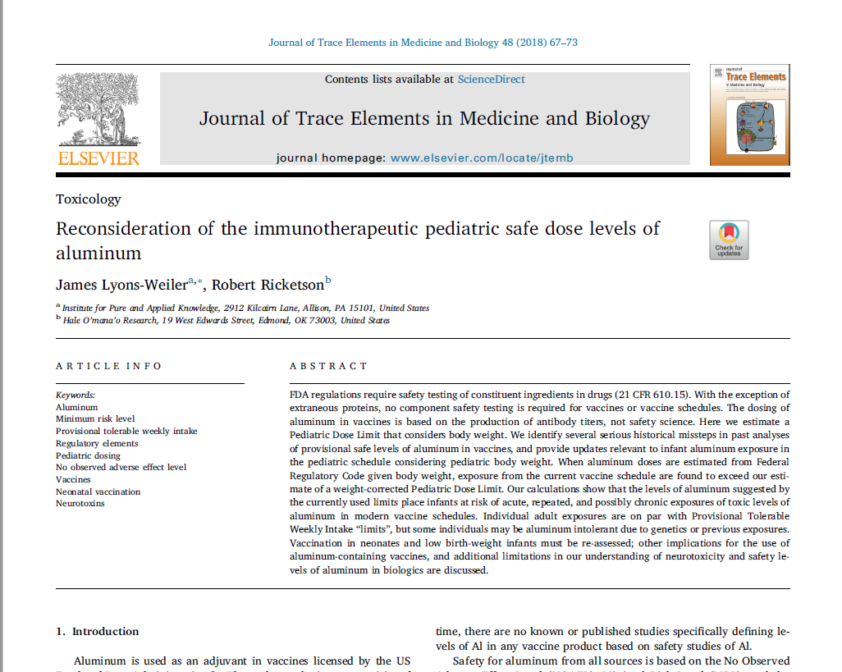
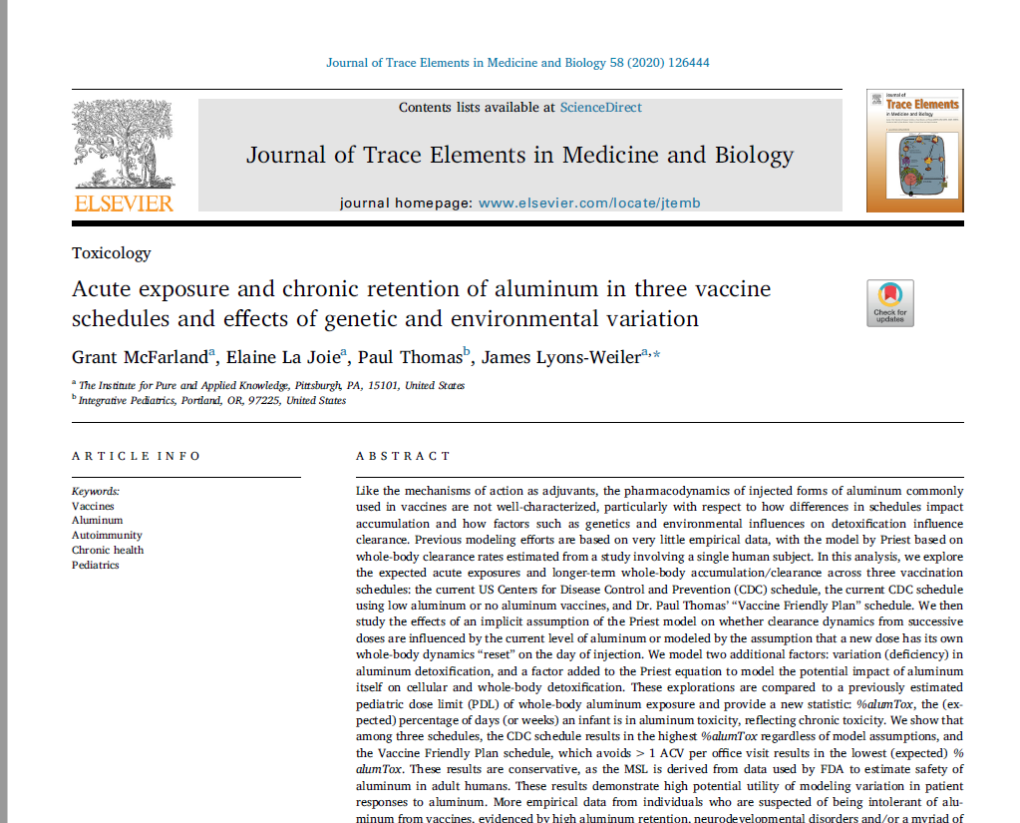
Blinded peer-review
2018
2020

Slide 3
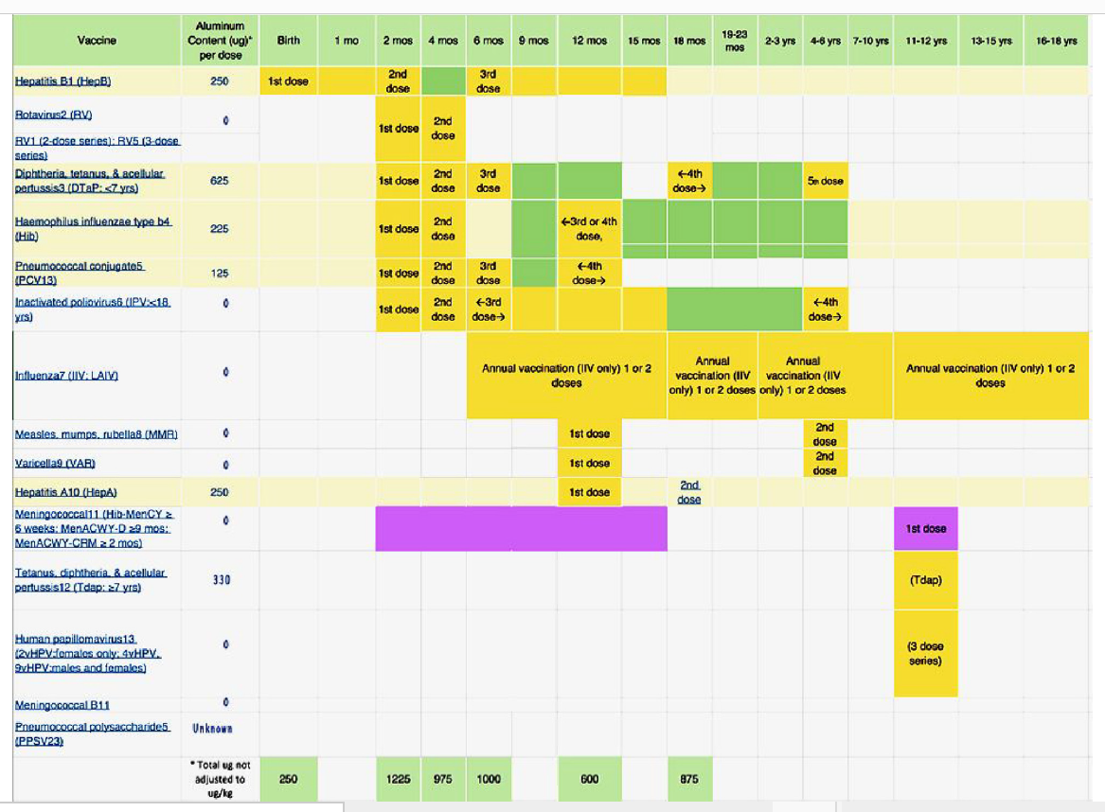
CDC

Slide 4
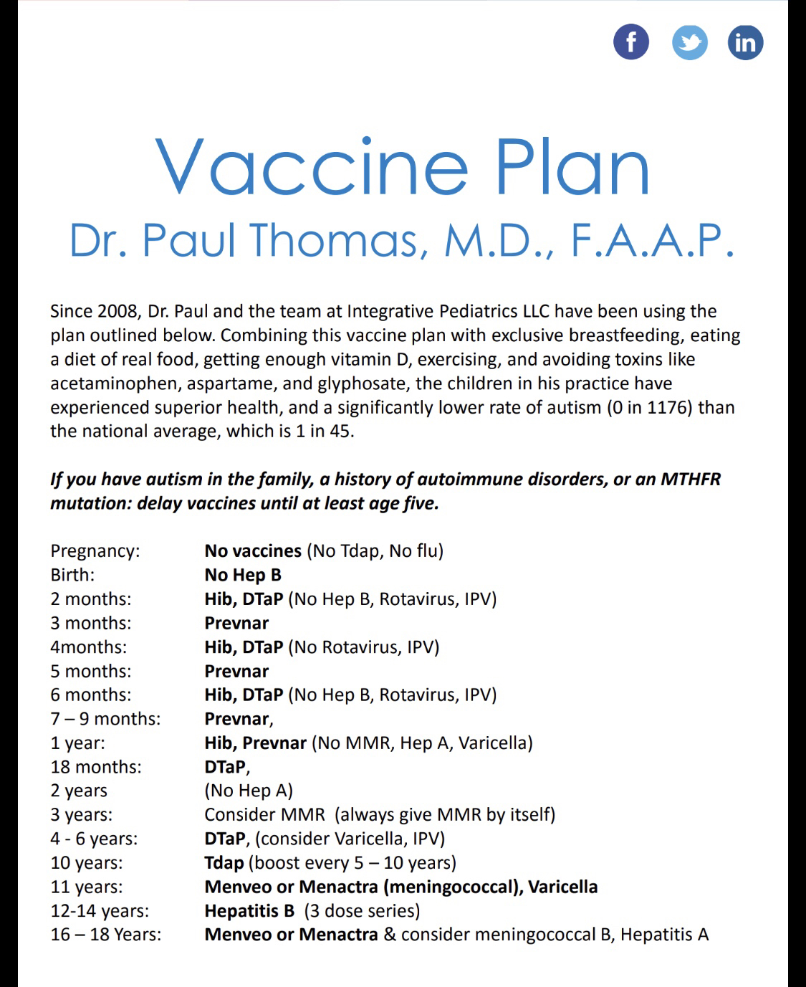
Vaccine Friendly Plan

Slide 5
Why Reduce Aluminum?
Aluminum is found in amyloid, the protein/non-protein aggregates in Alzheimer’s brain
Aluminum hydroxide is used to routinely and reliably induce autoimmune conditions in animals (mice & rats)
Disruption of erythropoesis and RBC function
Osteomalacia in bone
Cholestasis in liver
Aluminum inhibits defensive mechanisms connected with white blood cells and macrophages
https://www.ncbi.nlm.nih.gov/pubmed/16146022

Slide 6
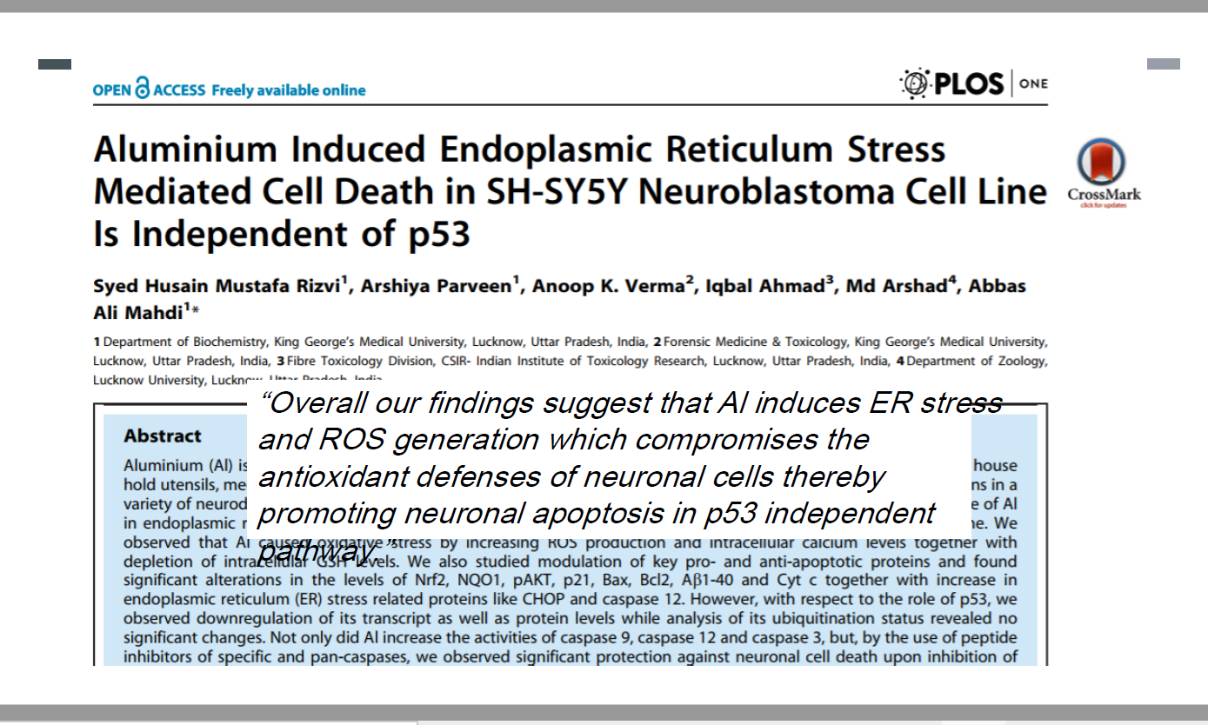

Slide 9
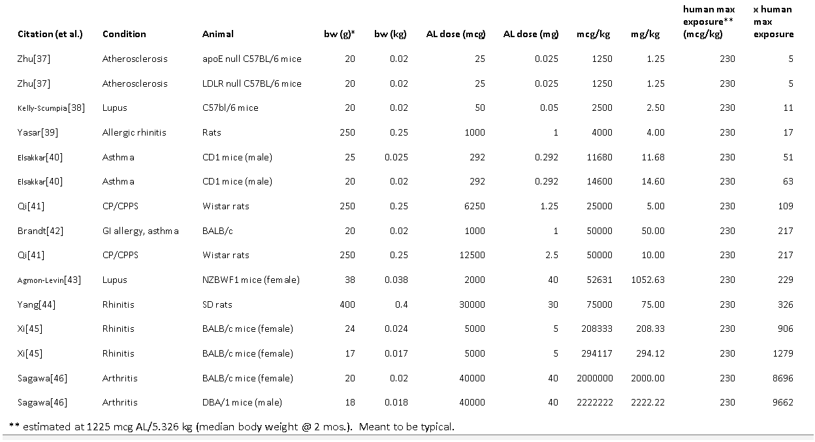

Slide 10
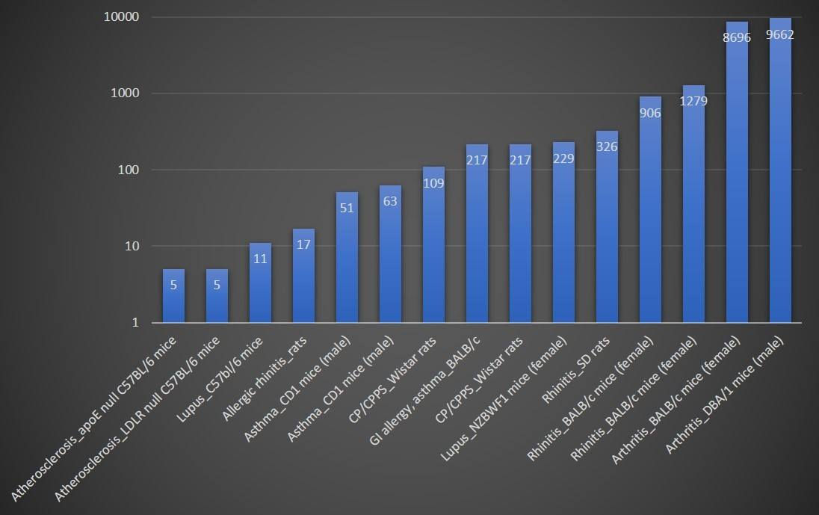
Genetic risk animal models

Slide 11
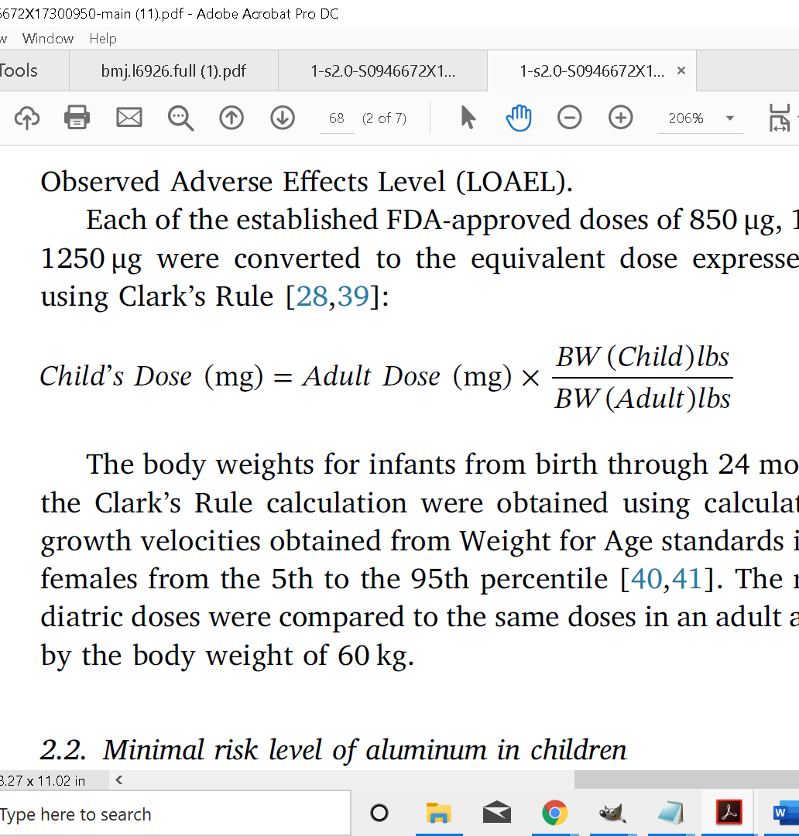
Clark’s Rule
FDA Adult Limit 850 mcg per dose
FDA Pediatric Limit: ????????????

Slide 12
Mitkus et al. – The FDA’s Paper on Aluminum
Used a model by Priest et al .which is based on human clearance of citrated aluminum forms (form in vaccines are not citrated)
Data for the models in two studies were from 1 and 6 males (adults)
Mitkus adjusted the model using data from creatine in infants
MRL was derived from ATSDR oral limits
ATSDR had picked 1 study and misrepresented the findings of Golub et al. [Next Slide]
In P/K, the focus tends to be on plasma/serum clearance
Mitkus assumes excretion via the kidney is similar to creatine (aluminum damages animal tissue) [Incorrect]
Our concern is the accumulation (body burden) originally realized in the first Priest et al. study [because aluminum has known toxic effects in human tissue]

Slide 13
Provenance of PTWI Limit ERROR found by Lyons-Weiler & Ricketson (2018)

Slide 14
Disagreement Between Two Committees
JEFCA
Joint FAO/WHO Expert Committee on Food Additives
ATSDR
Agency for Toxic Substances Disease Registry
1989. Provisional Tolerable Weekly Intake (PTWI) established at 1 mg/kg all dietary sources and additives. Mean highest daily intake US children 0.5 mg Al/kg per day¹
2011. Previous PTWI of 1 mg Al/kg withdrawn. Revised PTWI to 2 mg/kg (adults)²
2008 (CAS ID #: 7429-90-5)³
Daily dietary intake of Al 2 mg/kg-day in adults
Minimal Risk Level (MRL) 1 mg/kg-day (adults) same as No Observed Adverse Effect Level (NOAEL)
¹Evaluation of certain food additives and contaminants [Thirty-third report of the Joint FAO/WHO Expert Committee on Food Additives). WHO Technical Report Series, No. 776, 1989
² Evaluation of certain food additives and contaminants (Seventy fourth report of the Joint FAO/WHO Expert Committee on Food Additives) WHO Technical Report Series, JECFA/74/SC, 2011
³Agency for Toxic Substances and Disease Registry (ATSDR) CAS ID #: 7429-90-5

Slide 15
How did 1 mg Al/kg week become 1 mg/kg –day and 850 mcg per dose regardless of body weight
1981-CFR amended to include 1250 μg/dose
1996-2007 PTWI estimated at 1 mg/kg/week; 0.5 mg/kg-day US child > 2 years of age (WHO Evaluation and Certain Food Additives and Contaminants. Section 4.1 Aluminum, 1996-2007)
1996 Committee on Nutrition Aluminum Neurotoxicity in Infants and Children (J Pediatrics),
1 mg/kg-day (in error as to PTWI- “provisional tolerable intake”)
2001 0.85 mg "selected empirically from data because it enhance the antigenicity and effectiveness of the vaccine" (Baylor et al 2001)
2001-2008 ATSDR set MRL/NOAEL to 1 mg/kg-day from all sources based on Golub 26 mg/kg-day NOAEL (ATSDR references Baylor et al (2001),
2001 MRL/NOAEL 2 mg/kg-day in adult humans from dietary sources (Golub et al 2001 (62 mg/kg-day, Keith et al)
2011 MRL=1 mg/kg bw/day (ATSDR, 2008), Mitkus (2011)
2017: CFR is 850 μg/DOSE.

Slide 16
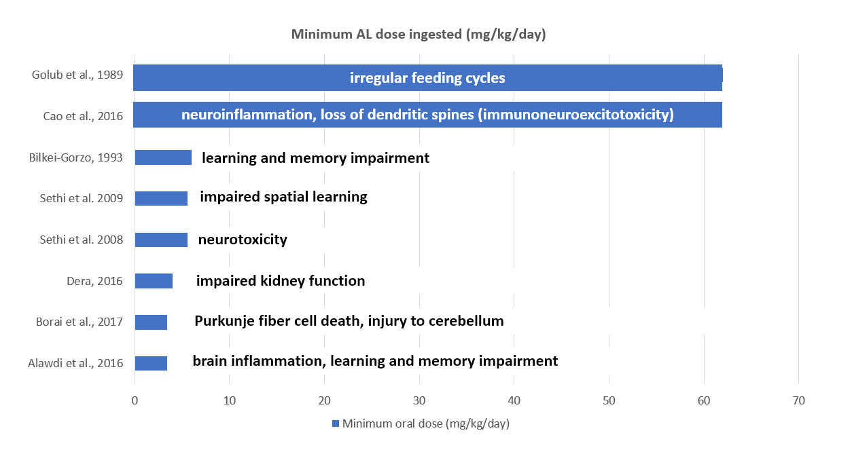

Slide 18
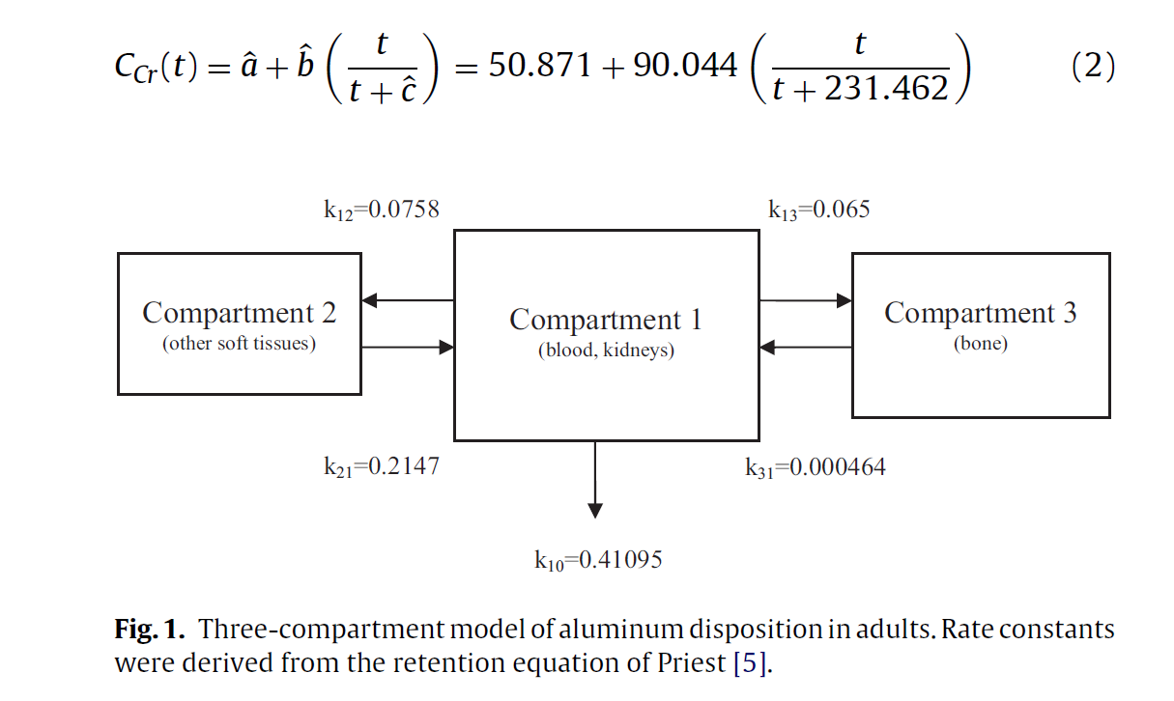
Mitkus’ Three-Compartment Model

Slide 19
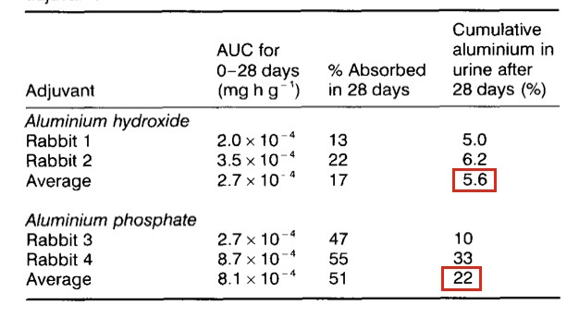
Flarend Rabbit Study (N=6)
Injected radioactive ALPO4 and ALOH3 into rabbits
Only 5.6% of the ALOH3 had been cleared from the body after 28 days (22 days fors ALPO4)

Slide 20
Flarend found low clearance rate from blood
“The aluminum concentration [in blood] produced by AH [Al hydroxide] adjuvant at 1 hour was similar to the concentrations found from 2 to 28 days.”
Clearly something is different between rabbits and humans?

Slide 21
Movsas Infant Study (N=15)
Found aluminum serum levels rose 1% immediately after vaccination.
“We were reassured to find no significant postvaccine rise in serum aluminum level after vaccination of preterm infants with vaccines containing a total of 1200 μg of aluminum.“ (JAMA Pediatrics, Letter)
?

Slide 22
Our Question
If 850-1150 mcg is a regulated level per dose in human adults (FDA), since FDA has never published a pediatric dose limit (PDL) for humans, what might a scaled human dose limit look like?
We considered bodyweight and allometric scaling (Clark’s Rule)
We adapted Priest’s model as a liberal model of excretion.

Slide 23
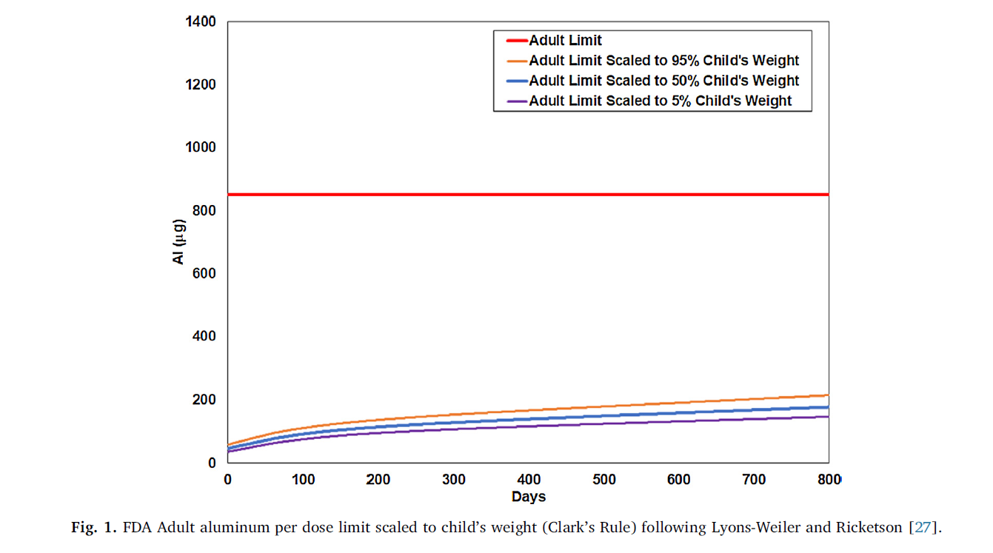

Slide 24
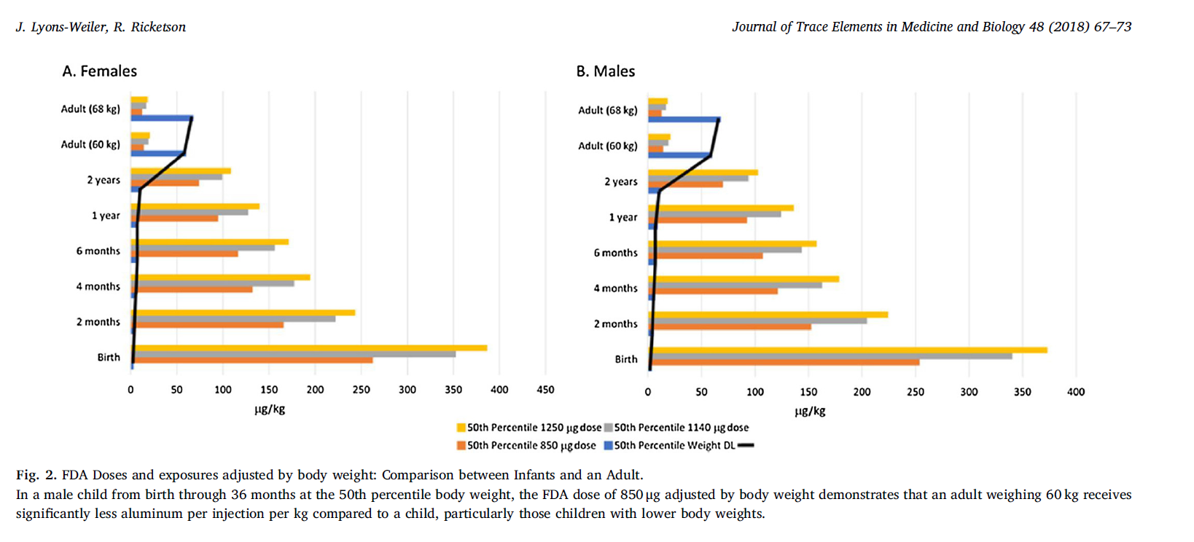

Slide 25
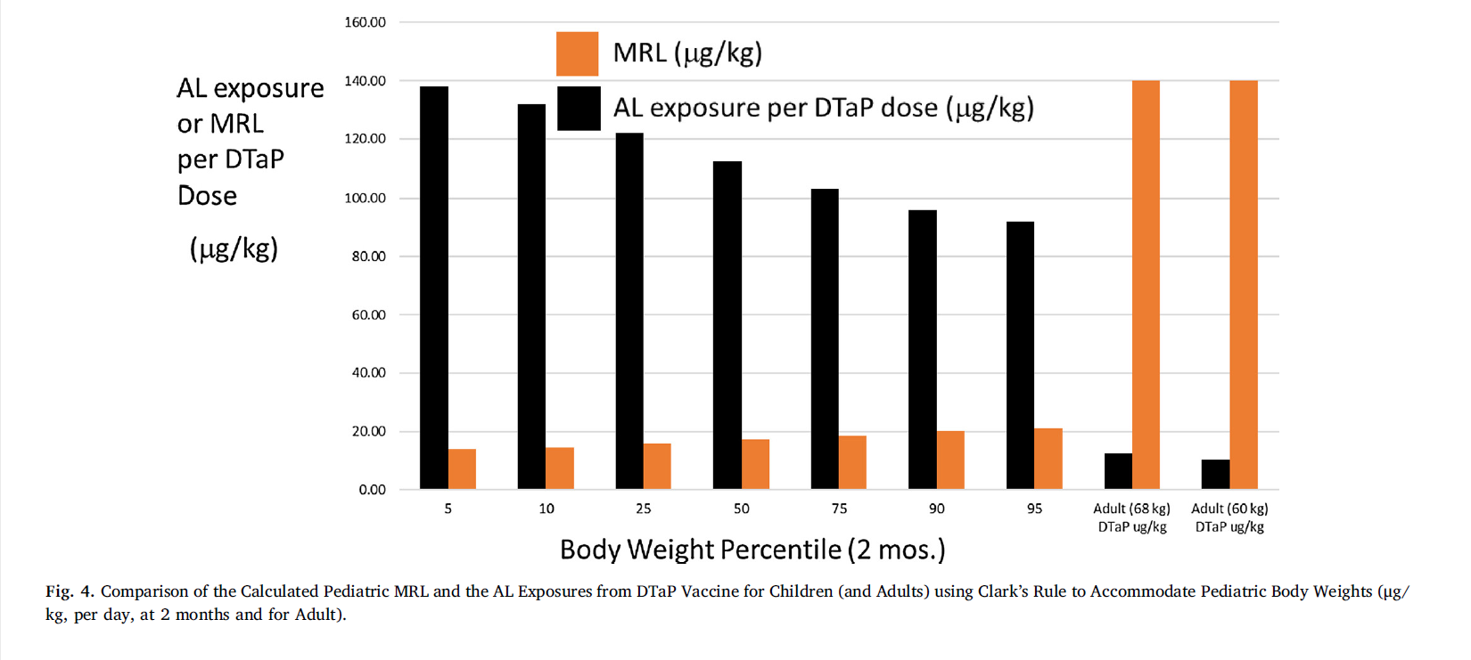

Slide 26
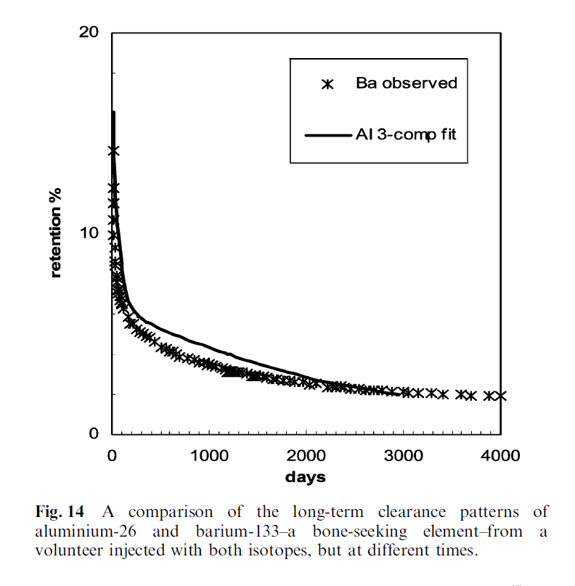
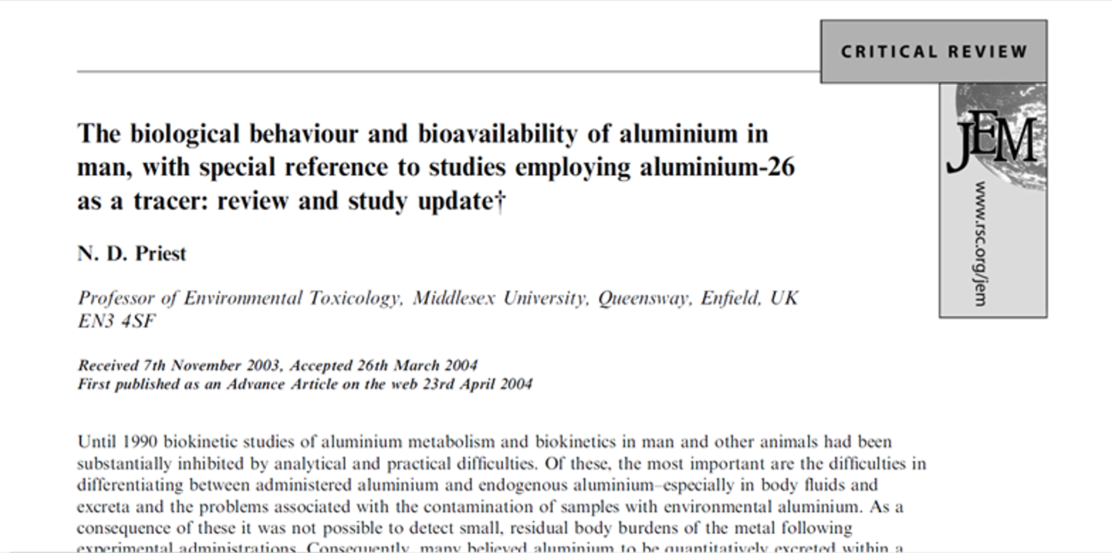
Priest model
Clearance of single doses in a few individuals

Slide 28
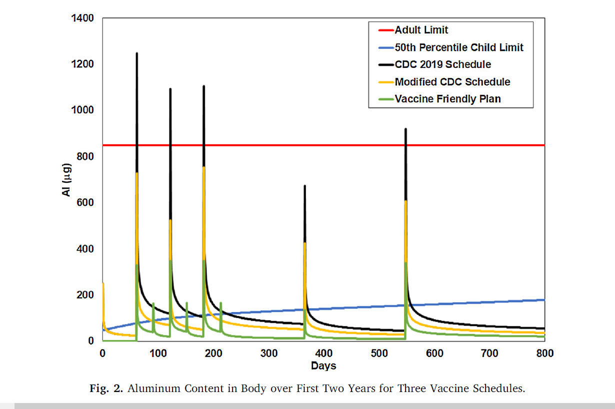

Slide 30
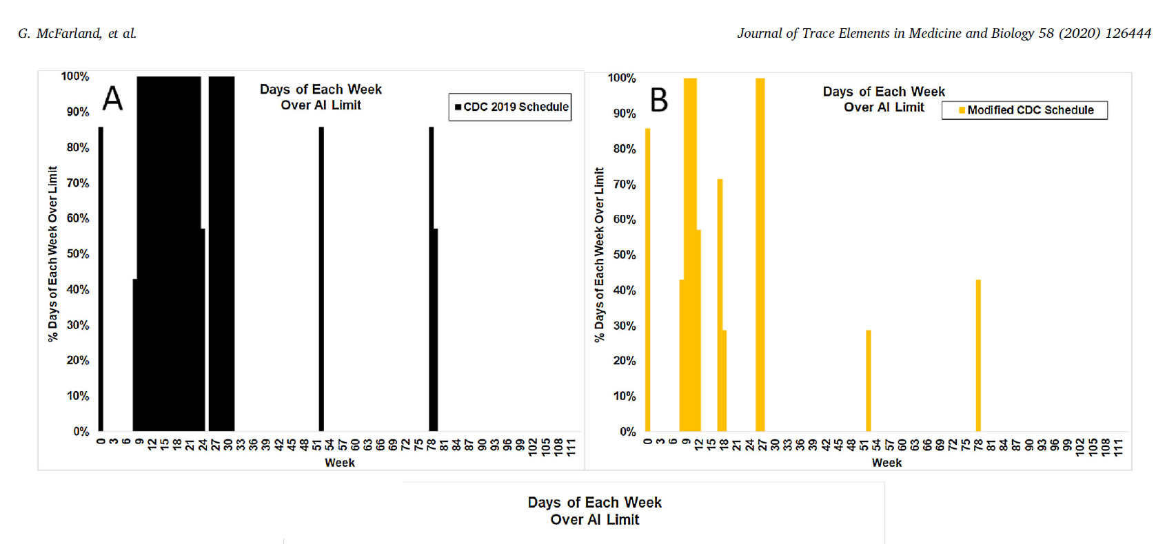

Slide 31
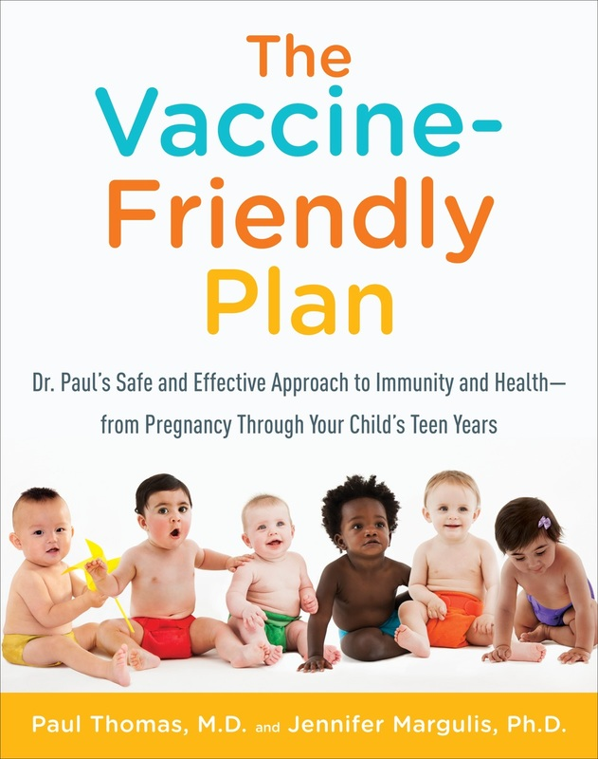

Slide 32
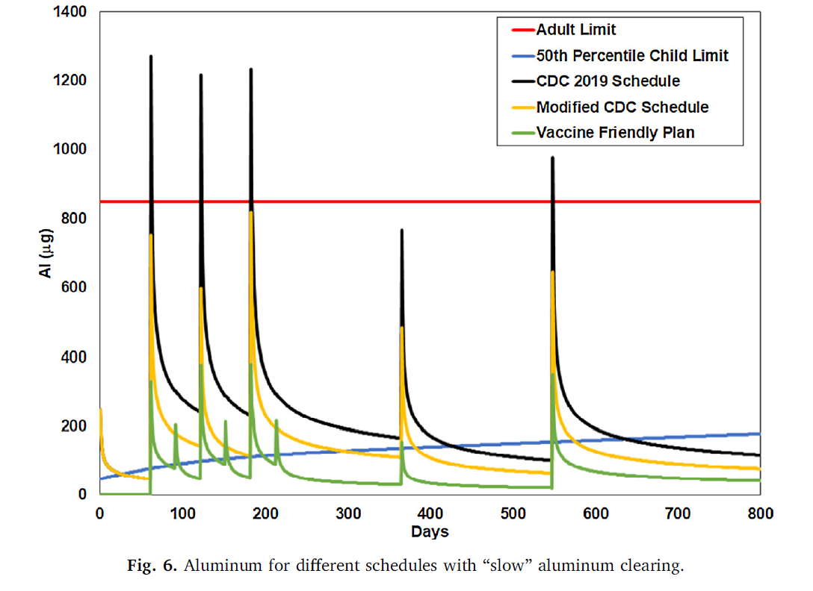

Slide 33
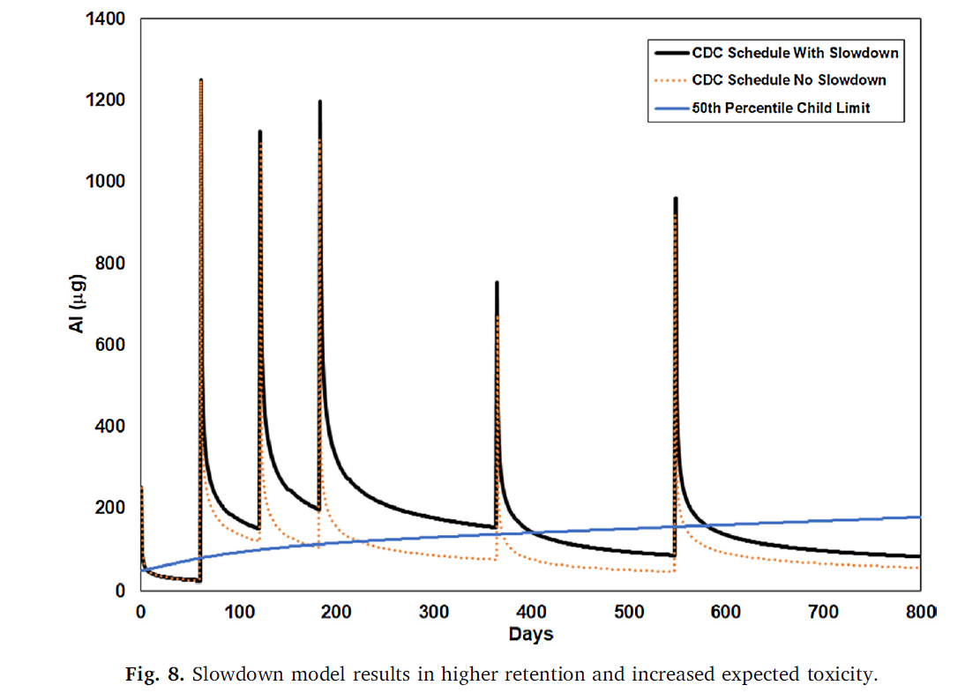

Slide 35
Recommendations
Perform per body-weight dose escalation studies in mice using injected forms of aluminum in infant mice
Re-evaluate the use of aluminum in vaccines altogether
Encourage awareness of the differences between vaccine risk awareness, which can lead to improvements in vaccines, and “Anti-vaccination” positions

Slide 36
Next Steps
IPAK Vaxxed vs. Unvaxxed Study
Analysis of Health Outcomes in >3300 children born into Dr. Paul’s Practice
681 Unvaccinated, 2647 Variably Vaccinated (VFP)
IRB Approved
Phase 1 is complete, under review
Results include Health Outcomes risk from ACV’s cf. All Vaccines (% liability)

Slide 37
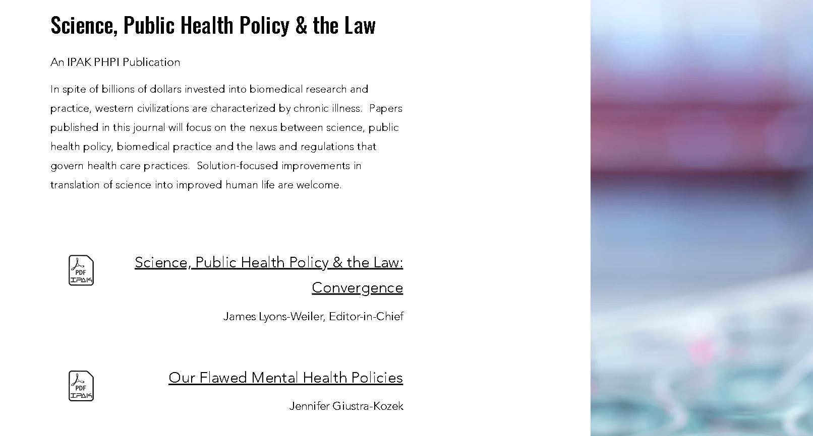

Slide 38
